Slide 1
Model Selection
Instructor: Hamed Hasheminia
Lecture 6

Slide 2
Agenda
Bias-Variance Trade off
Validation (Test vs Train set)
Cross-Validation
Ridge and Lasso Regression
(Optional) Backward Selection, Forward Selection, All Subset Selection. (If you want to use these methods you need to use R)

Slide 3
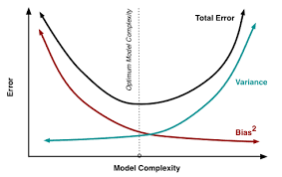
Bias – Variance Trade-off

Slide 4
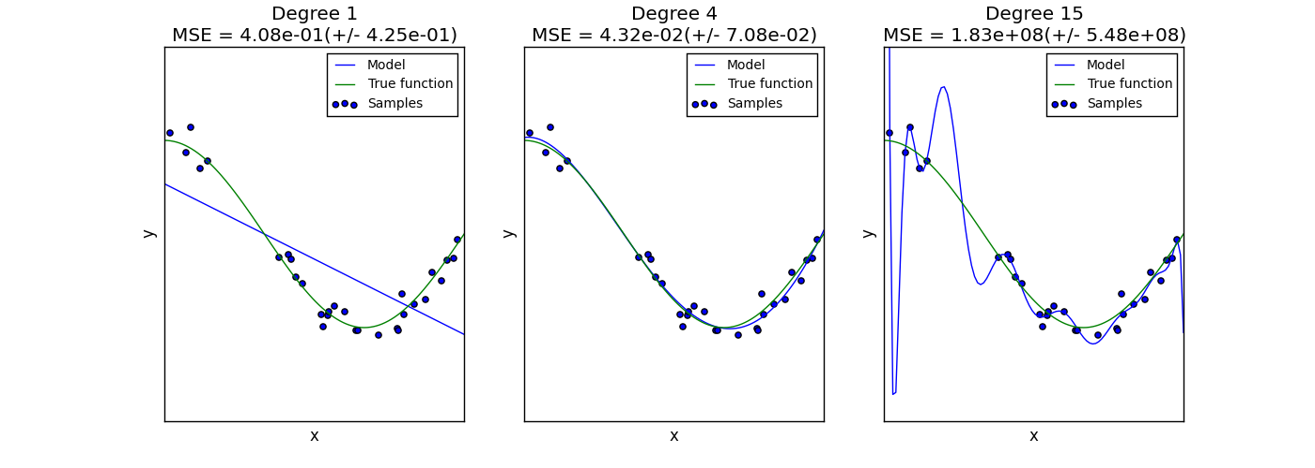
Bias – Variance Trade-off

Slide 5
Validation
We divide our dataset to test and training.
We then train our algorithms with train data.
We compute test error by using predictions of our models on our test set.

Slide 6
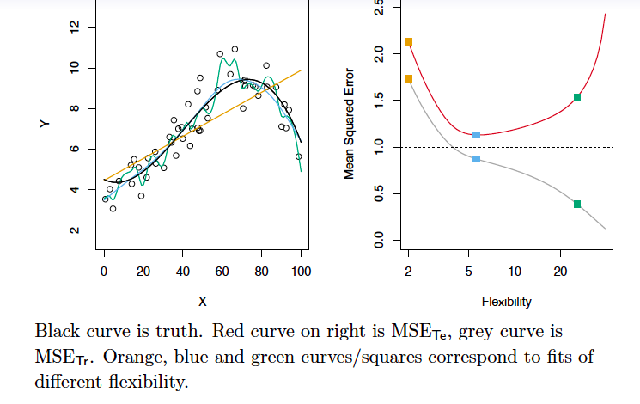
Validation example

Slide 7
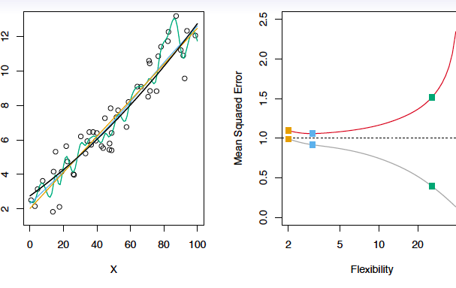
Validation Example

Slide 8
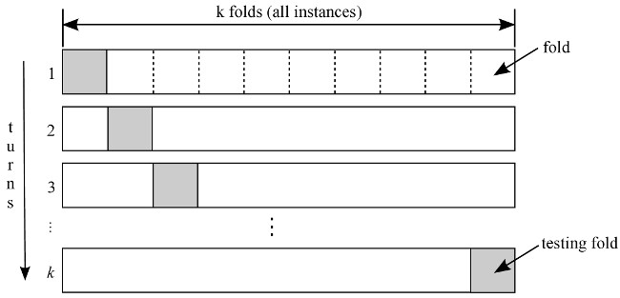
K-fold Cross-Validation

Slide 9
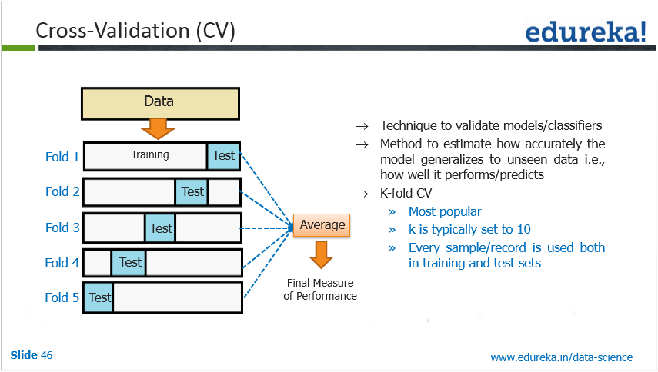
K-fold Cross-Validation

Slide 10
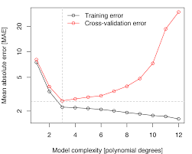

Slide 11
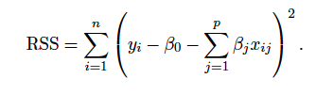

Ridge Regression (Shrinkage method)
In ridge regression we penalize our model for adding more variables:
Lambda > 0, is a tuning parameter. We set it by cross-validation

Slide 12

Ridge Regression
Coefficients in Ridge Regression are sensitive to scale of your data. It is highly recommended that you standardize your data before performing Ridge Regression. One way to standardize your data is dividing it by its standard deviation. The other way, is chaining it to z-values.

Slide 13
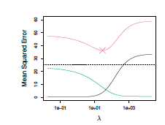
Bias-Variance Trade-off in choosing the best lambda

Slide 14

Lasso Regression
Lasso is very similar to Ridge regression. The only difference is it penalizes objective function with Norm 1 – summation of absolute values - instead of Norm 2.
As in Ridge regression, selecting a good lambda for the lasso is critical; cross-validation is again the method of choice.

Slide 15
Lasso Regression
As with ridge regression, the lasso shrinks the coefficient estimates towards zero.
However, in the case of the lasso, the Norm 1 penalty has the effect of forcing some of the coefficient estimates to be exactly equal to zero when the tuning parameter lambda is sufficiently large.

Slide 16
Other methods of model selection
Forward Selection (Python is not that good for this method)
Backward selection(Python is not that good for this method)
All subset selection(Python is not that good for this method)
Principle component methods. (Will cover that later in the course.)

Slide 17
Summary
Bias-Variance Trade-off
Validation
Cross-Validation
Ridge-Regression
Lasso-Regression
Backward, Forward, and all subset selection
Resource (Chapter 6): http://www-bcf.usc.edu/~gareth/ISL/data.html
Video Resource: http://dataminingclass.com/index.php/lectures/linear-model-selection-and-regularization/

